Slide 1

Tech for refugees: the Bristol Refugee Hackday
#BrisRefugeeHack
for & with

Slide 2
WHAT IS A HACKATHON?
Ideas and solutions from a wide range of people
Minimum process - strong outcomes
No limit to thinking
Inclusive, involved, shared, equal
Fun, fast, energetic, has purpose
#BrisRefugeeHack

Slide 3

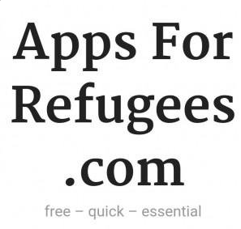






We are not alone

Slide 4
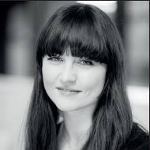
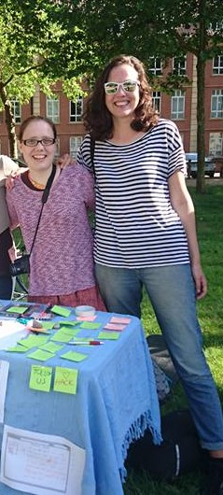
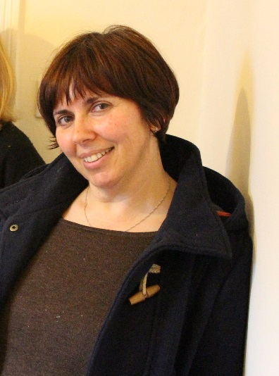
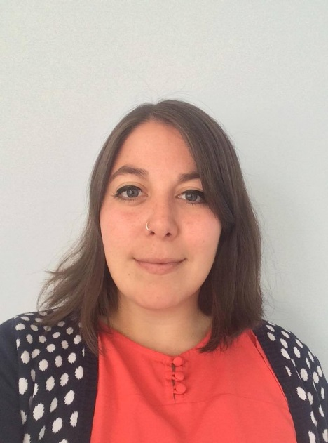
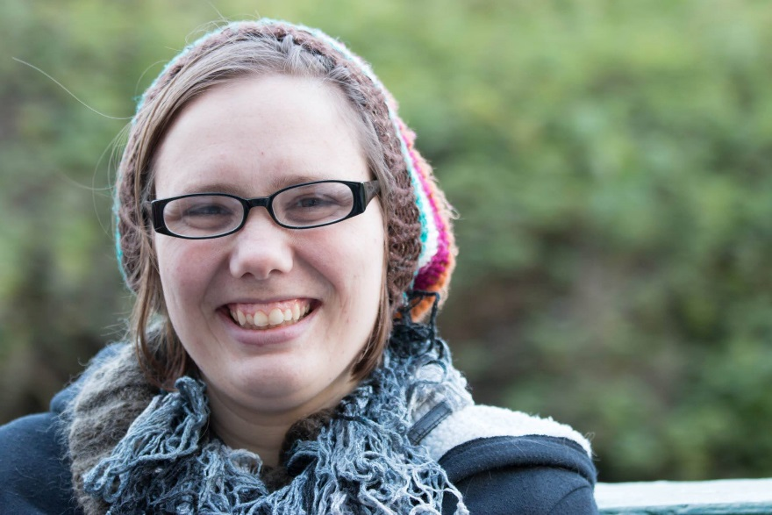
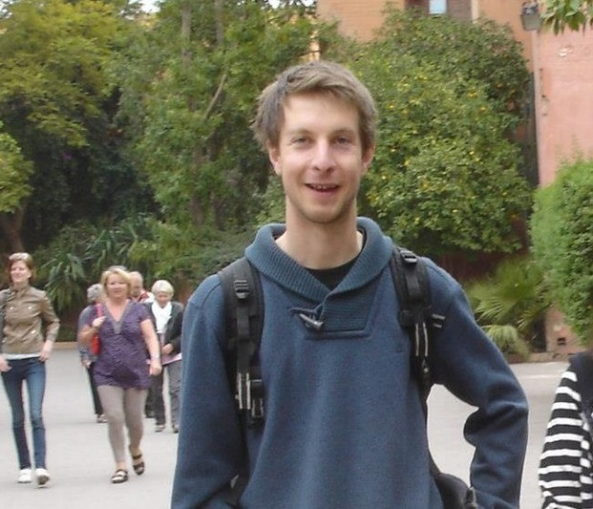
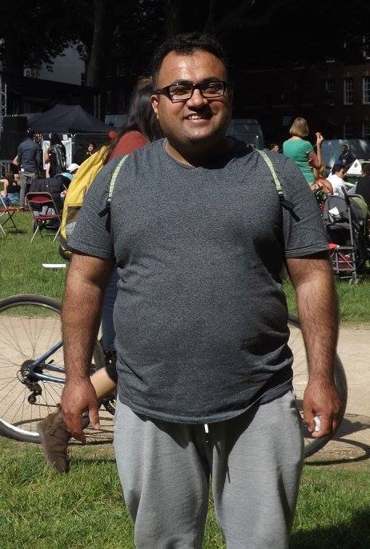
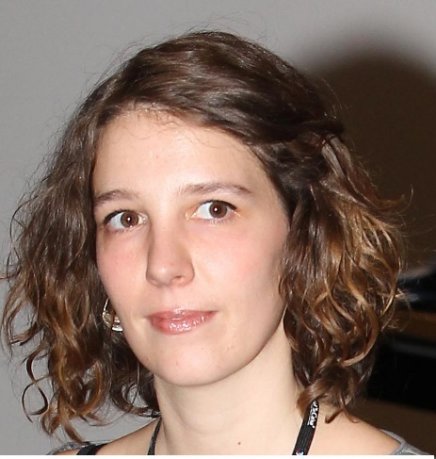
How to organise a Hackaton?

Slide 5





Reaching out: Our sponsors
& prize donors

Slide 6
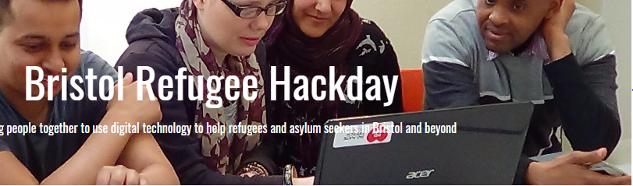
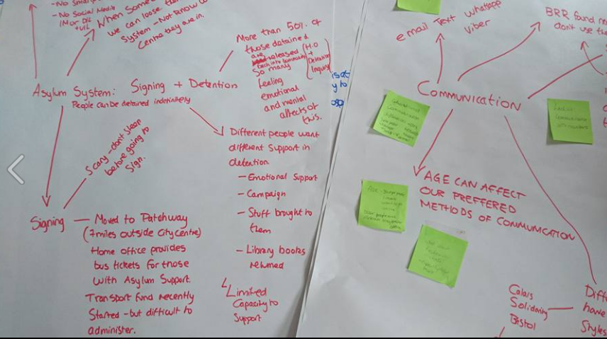
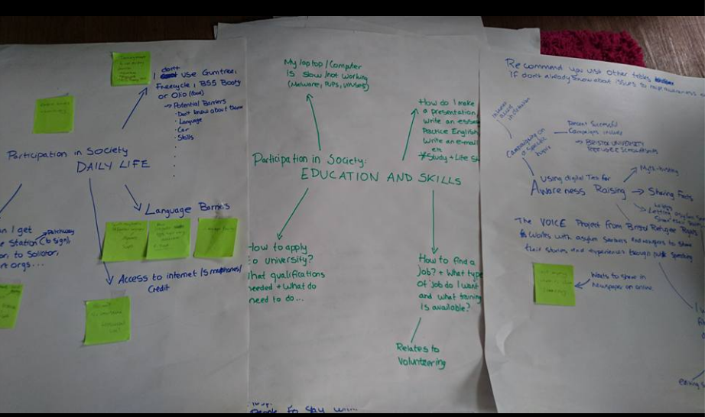
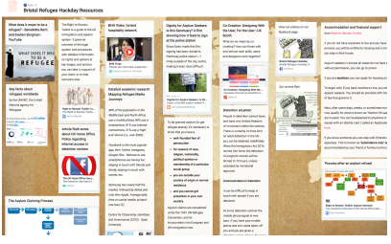
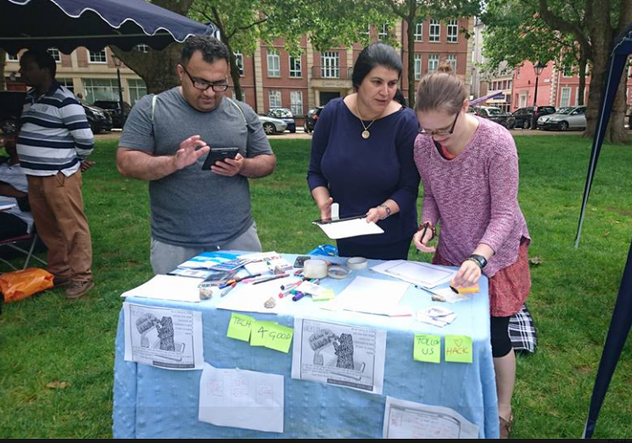
Research
How?

Slide 7
CO-CREATION
There is more than one EXPERT
Everyone can be CREATIVE
We can all LISTEN
#BrisRefugeeHack

Slide 8
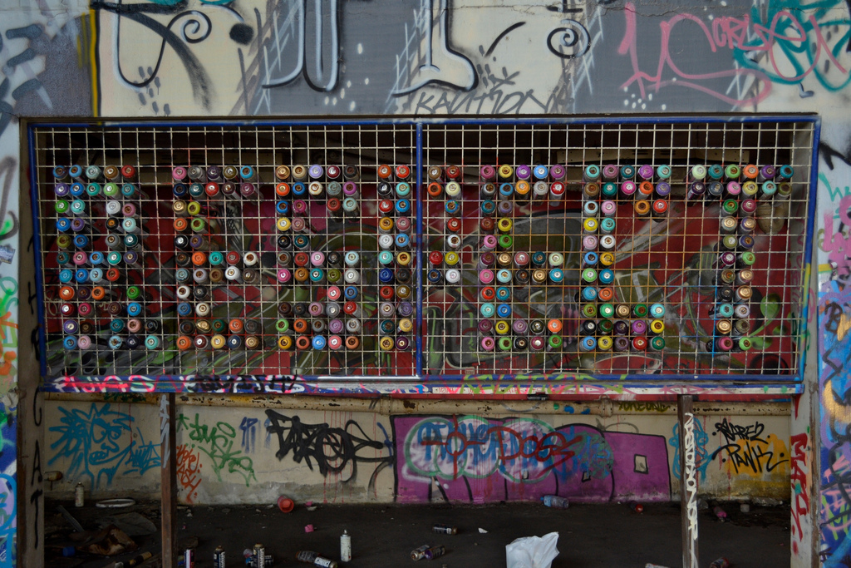
HD etiquette
Be respectful. Be thoughtful. Be open. Be awesome. https://hackbrightacademy.com/

Slide 9

BRHD today a network

Slide 10

Find us:
bristolrefugeehackday.wordpress.com
@BrisRefugeeHD

